Slide 1


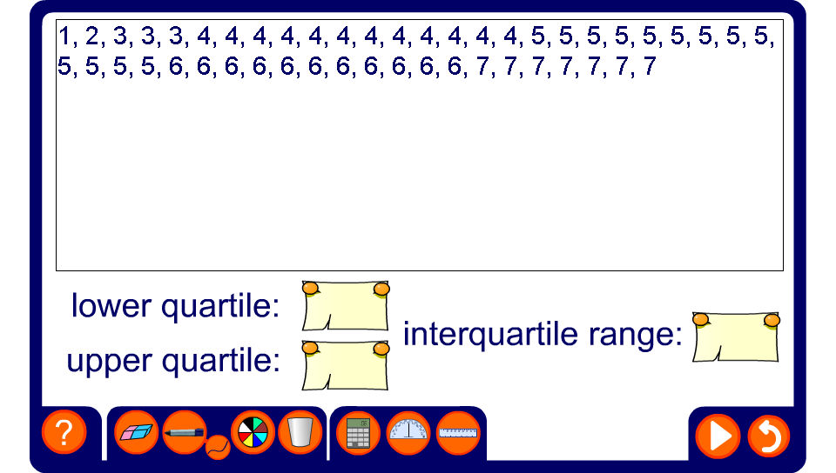


Finding the interquartile range
Notes:
Use the activity to discuss how to find the interquartile range. Resetting will produce a new data set.

